Slide 1
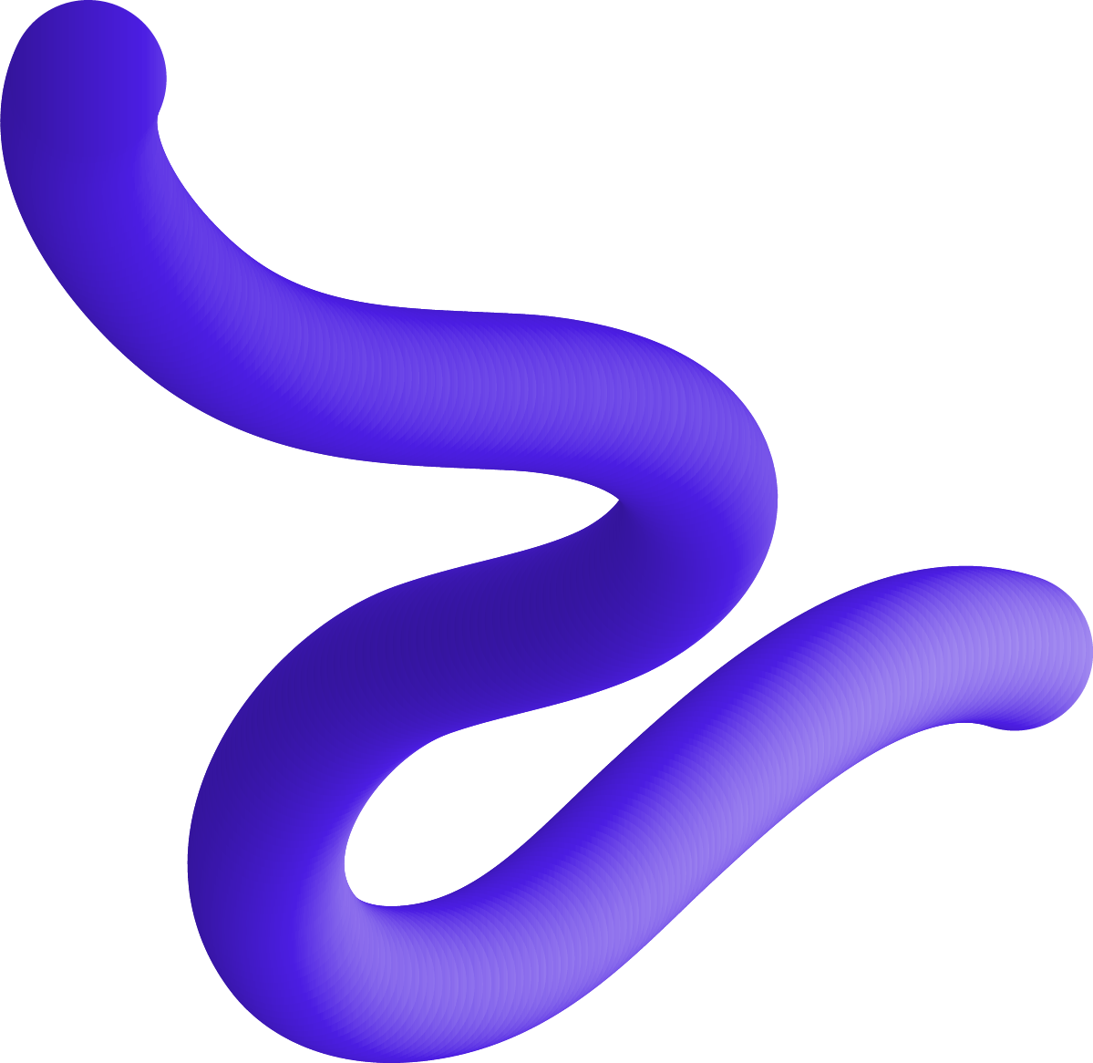
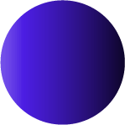
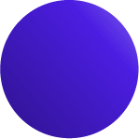
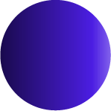

Grammar for fractals
Team 16: Botnari Ciprian, Guzun Grigore,
Cucoș Emanuil, Mirovskki Artiom

Slide 2
Presentation
01
04
02
05
03
06
Goal
Fractal
The ultimate objective of DSL
What we strive for to achieve
Grammar
Language
The structure of the language
Future of our DSL
Program
Conclusions
A sneak peek of how to create a fractal
Final acknowledgements

Slide 3
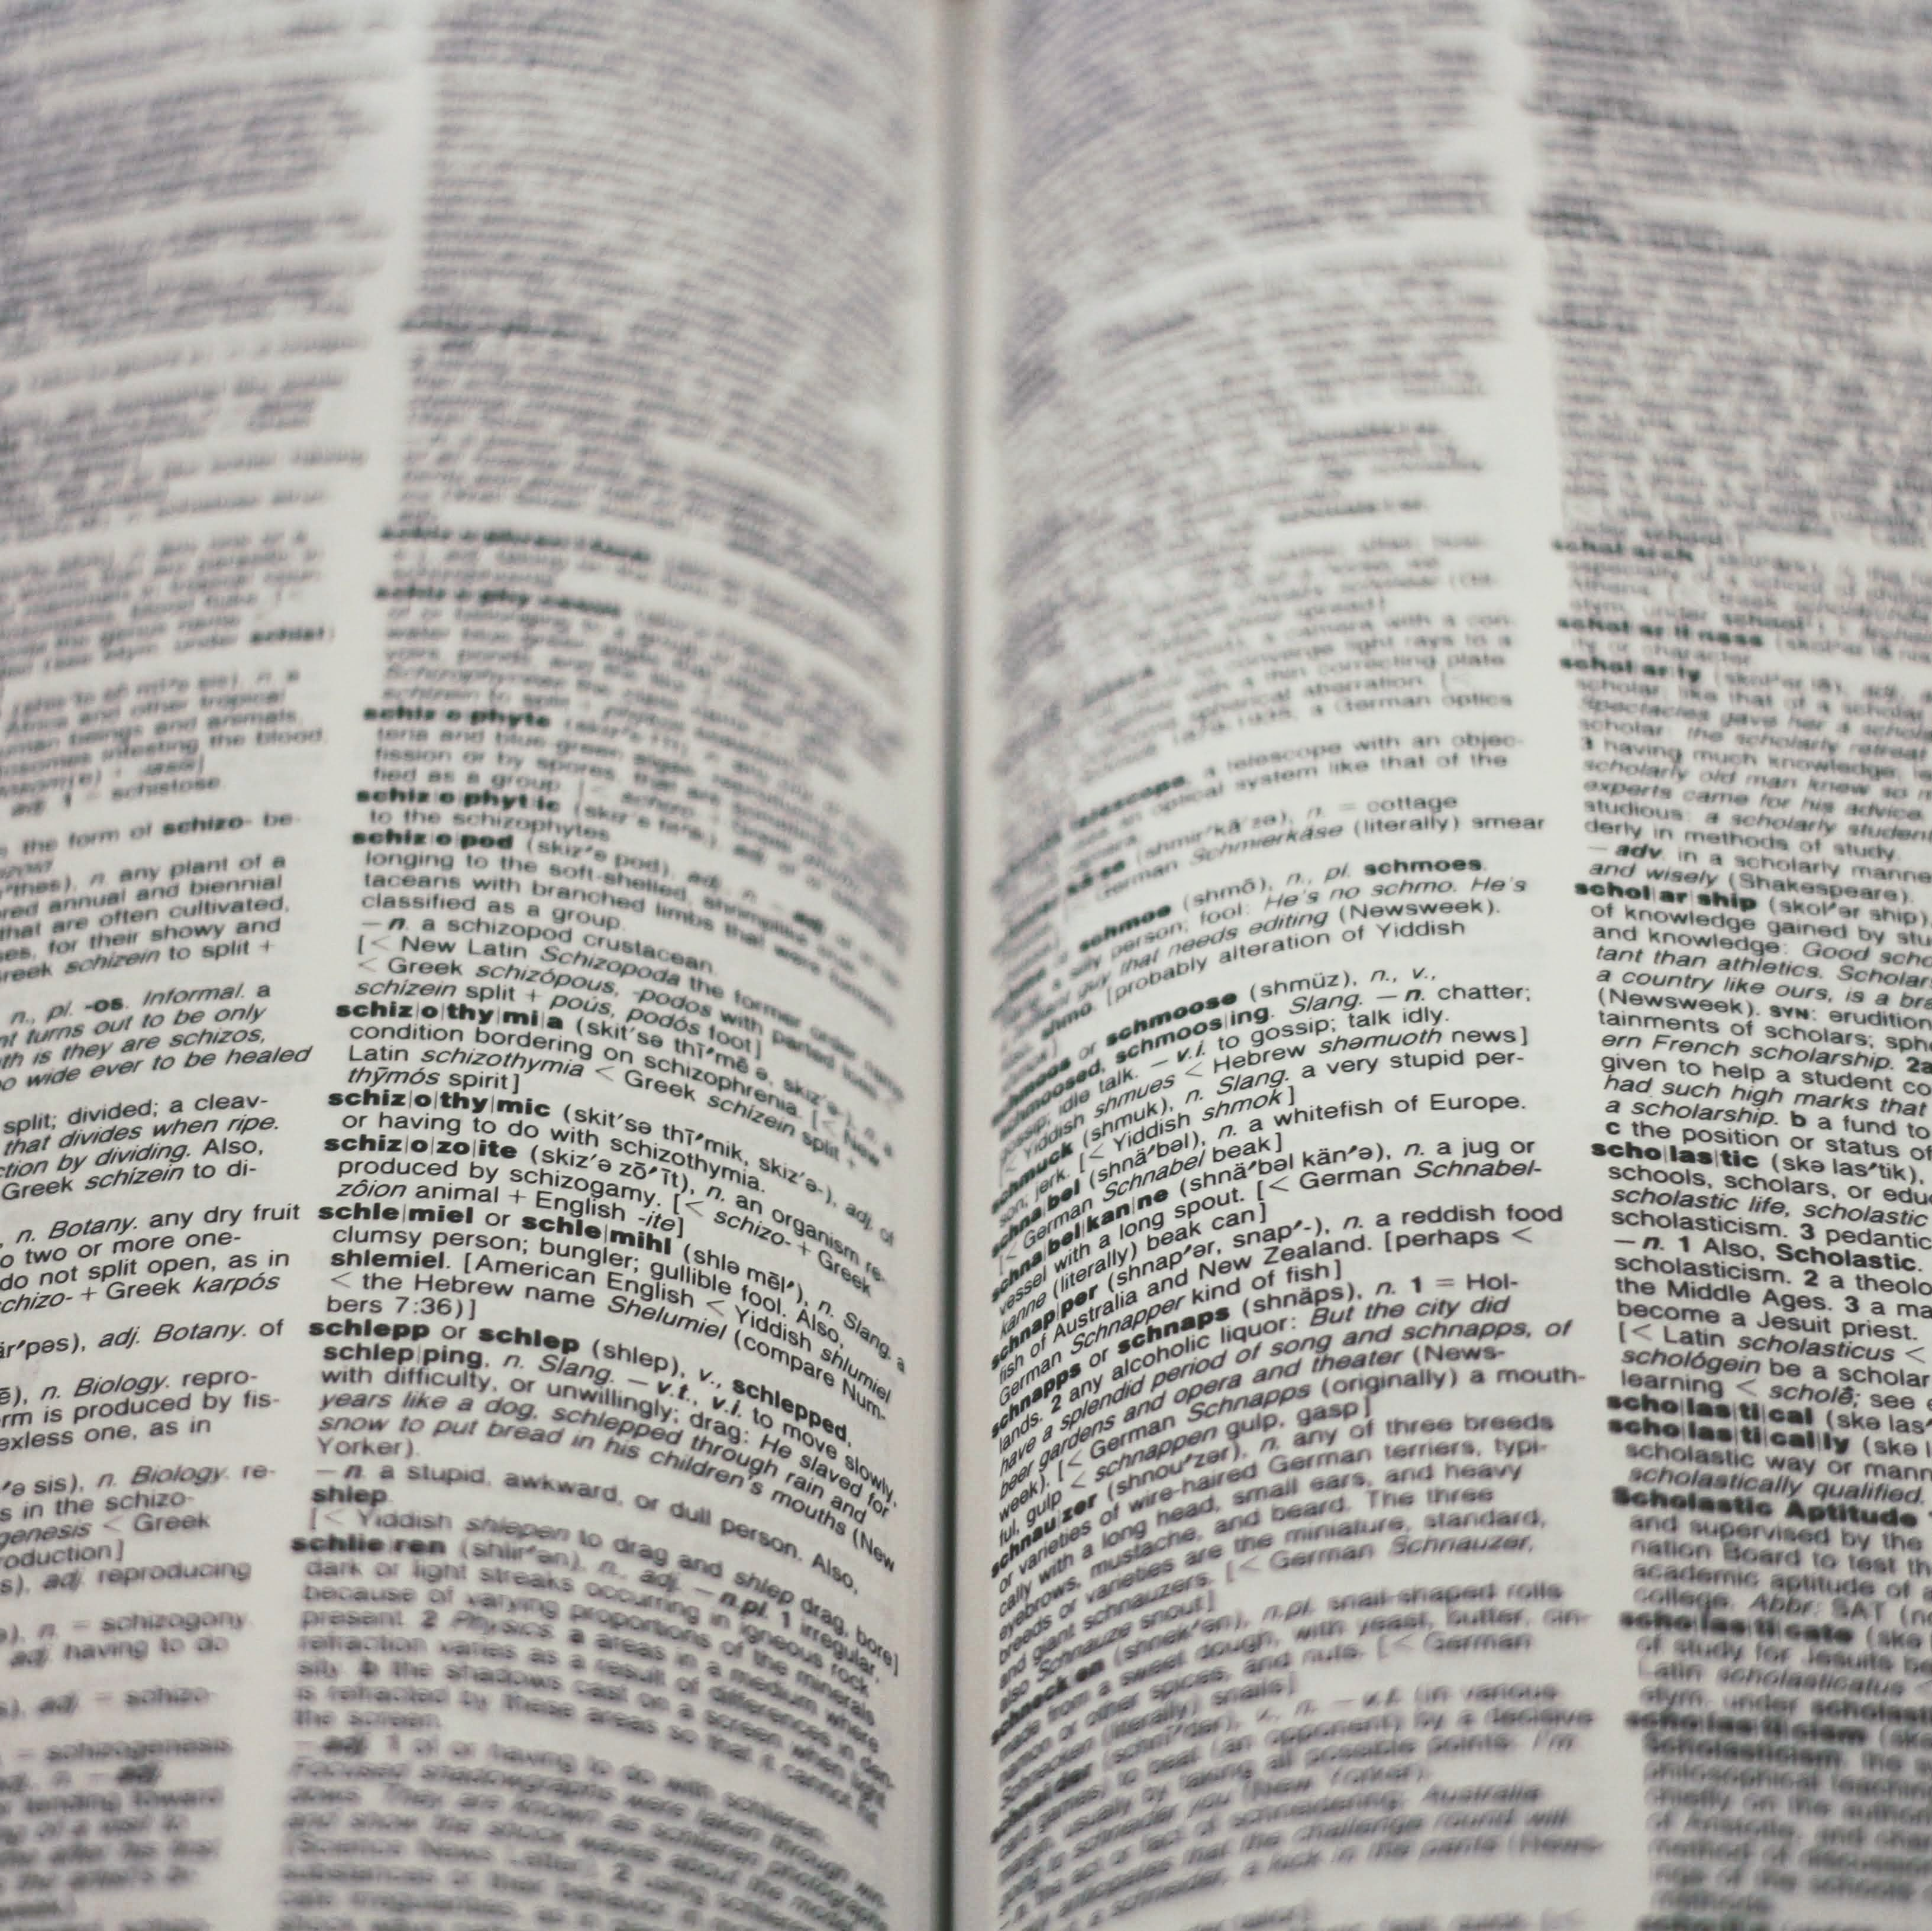
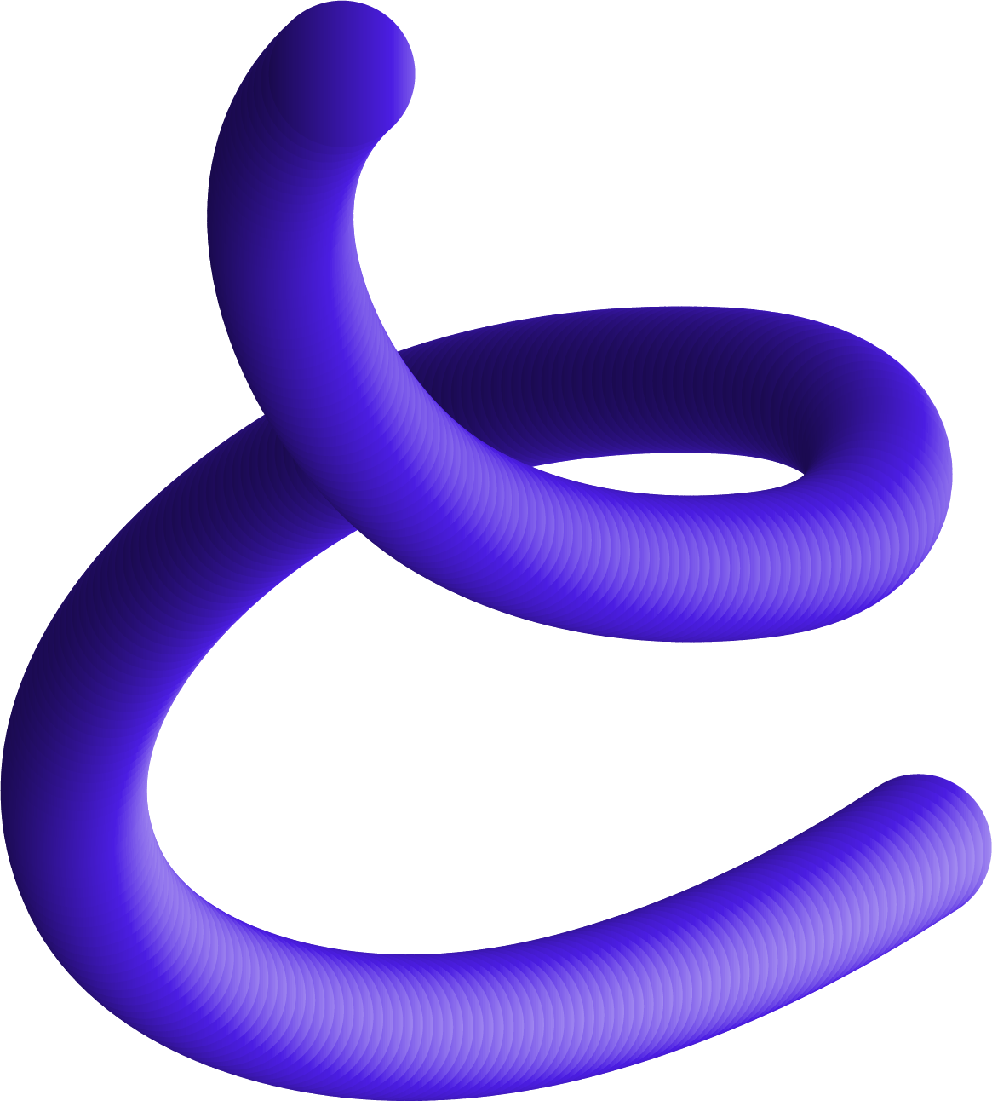
Goal
Fractals are complex mathematical objects that can be used to teach various mathematical and computer science concepts.
However, building them can be a challenging task, especially for educators and students who are not familiar with complex programming languages.
The goal of this DSL is to provide an easy-to-use and intuitive language for educators and students to build and explore fractals without the need for extensive programming knowledge.

Slide 4
Grammar (Work in Progress)
G = (VN, VT, P, S)
VN = {REPEAT, TIMES, START, WITH, SHAPE, CIRCLE, SQUARE, TRIANGLE, COLOR, BACKGROUND, SCALE, ROTATE, SAVE, AS, PNG, JPG, [A-Z], [a-z], [0-9], =, ., ,, [, ]}
VT = { <start>, <command>, <shape>, <transformation>, <color>, <repeat>, <save>, <lowercase>, <uppercase>, <number>}
P = { <start> -> command
<command> -> shape | transformation | color | repeat | save
<shape> -> circle(value) | square(value) | triangle(value) | polygon(sides, value)
<transformation> -> scale(value) | rotate(value)
<color> -> red | blue | green | yellow | black | white
<repeat> -> repeat(value) { command }
<save> -> save as file_type(filename)
<lowercase→ a – z; <uppercase> → A – Z; <number> → 0 - 9}
S = <start>

Slide 5
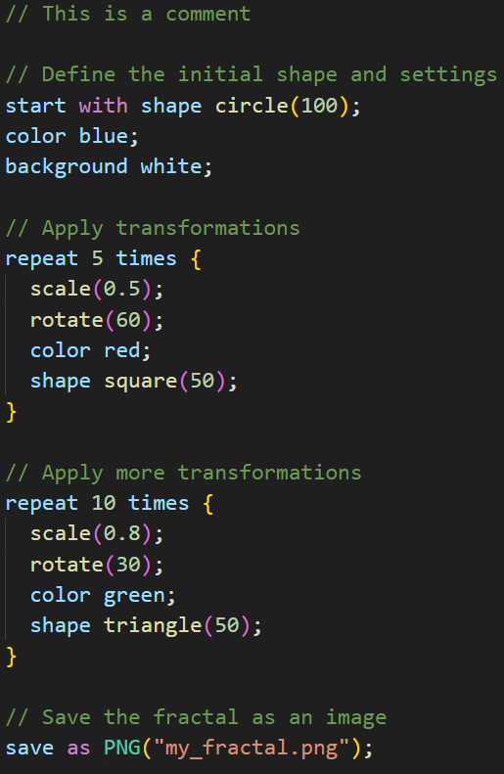
Program

Slide 6
Fractal

Slide 7
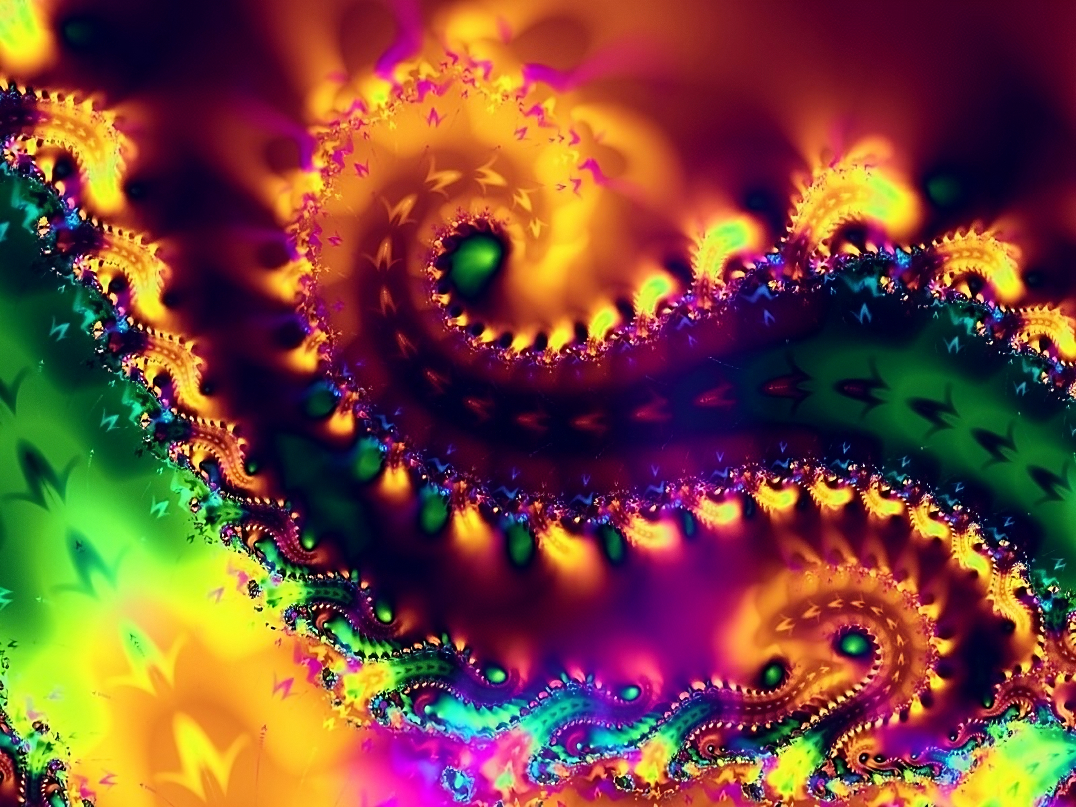
Notes:
What we strive to achieve for

Slide 8
Next steps
Lexical Analyzer
A software component that reads and analyzes the characters of a program's source code and generates a sequence of tokens that the compiler or interpreter can use
Symbol Table
A data structure that stores information about the identifiers used in a program, such as their name, type, and scope.
Scientific paper
In our scientific paper, we propose a domain-specific language (DSL) for building fractals that is specifically designed for educators and students.

Slide 9
Thank you for the attention

